Slide 1
Revised Version
2019-06-14

Slide 2
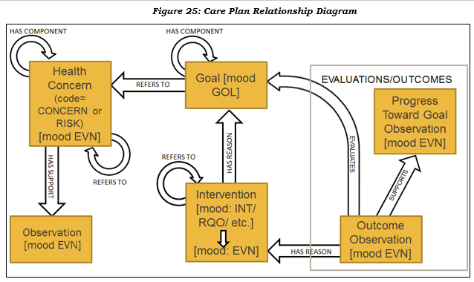
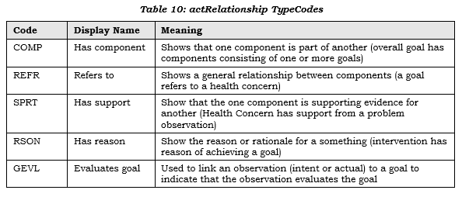
Care Plan Relationship Diagram Expressed in Wireframe Format
C-CDA R2.0, R2.1
Care Plan
Header
Has
component
Refers to
Health Concerns
Has
support
Has
component
Goals
Refers to
Refers to
Interventions
Has
reason
Has
reason
Has
support
Evaluation & Outcomes
Evaluates
goal

Slide 3
Information Relationships: Clinical Summary to PACP Document
Personal
Advance Care Plan
Clinical Summary*
Header
Header
Personal Advance Care Plan
Information in the
Advance Directives section of a
Clinical Summary can :
Healthcare Agents
Other Sections
1
1
Point to the PACP as an external document if one was referenced.
Identify which healthcare agent was involved in decision making during the care encounter.
Indicate the type of emergency, critical, or advance care planning information verified to be present in the PACP.
Provide rationale for procedures performed or not.
Provide rationale for tests performed or not.
Provide rationale for the recommended plan of treatment.
Procedures
GPP End-of-Life
2
4
Results
2
3
GPP After Death
5
Plan of Treatment
4
GPP for Personal Care Experience
6
3
5
Advance Directives
Witness & Notary
6
* Continuity of Care Document, Consultation Note, Referral Summary, Transition of Care Document
GPP = Goals, Preferences, and Priorities

Slide 4
Information Relationships: Care Plan to PACP
Personal
Advance Care Plan
Care Plan
Header
Header
Personal Advance Care Plan
Information in an “additional”
Advance Directives section of a
Care Plan document could :
Healthcare Agents
Health Concerns
7
Point to the PACP as an external document if one is available.
Identify which healthcare agent is participating in care planning.
Indicate the type of emergency, critical or advance care planning information present in the PACP.
Provide rationale for planned interventions.
Inform goal setting.
7
GPP End-of-Life
Goals
8
9
8
10
GPP After Death
Interventions
10
11
11
GPP for Personal Care Experience
Evaluations & Outcomes
9
Witness & Notary
Advance Directives
Open
Template
GPP = Goals, Preferences, and Priorities

Slide 5
Information Relationships: Combined View
Personal
Advance Care Plan
Clinical Summary*
Care Plan
Header
Header
Header
Personal Advance Care Plan
Healthcare Agents
Health Concerns
Other Sections
1
7
Procedures
GPP End-of-Life
Goals
4
10
2
8
Results
GPP After Death
Interventions
5
11
Plan of Treatment
GPP for Personal Care Experience
Evaluations & Outcomes
6
3
9
Advance Directives
Witness & Notary
Advance Directives
Open
Template
* Continuity of Care Document, Consultation Note, Referral Summary, Transition of Care Document
GPP = Goals, Preferences, and Priorities

Slide 6
Prior Version

Slide 7
Translation of prior care plan relationship diagram to new format
C-CDA R2.0, R2.1
Care Plan
Header
Care Team Member
Refers to
Has Component
Health Concerns
Has Support
H
M
Has Component
Goals
Refers to
H
M
Refers to
Interventions
Has Reason
H
M
Supports
Evaluation & Outcomes
Has Reason
H
M
Evaluates
H = Human Readable Content
M = Machine Readable Entries

Slide 8
Personal advance care plan document relationship diagram to C-CDA Advance Directives Section
Personal Advance
Care Plan Document
Clinical Summary*
Care Plan
Header
Header
Header
Care Team Member
Refers to
Other Sections
Healthcare Agents
Has Component
Health Concerns
H
H
Has Support
H
M
M
M
Procedures
GPP End-of-Life
Has Component
Goals
Refers to
H
References
H
H
M
M
M
Results
GPP After Death
Refers to
Interventions
Has Reason
H
Informed by
H
H
M
M
M
Plan of Care
Care Experience
Supports
Evaluation & Outcomes
Has Reason
H
H
H
M
M
M
Evaluates
Summarizes
Advance Directives
Witness & Notary
H
H
M
M
* Continuity of Care Document, Consultation Note, Referral Summary, Transition of Care Document
GPP = Goals, Preferences, and Priorities
H = Human Readable Content
M = Machine Readable Content

Slide 9
“Future Potential” Personal advance care plan document relationship diagram
Personal Advance
Care Plan Document
Clinical Summary*
Care Plan
Header
Header
References
Header
Informed By
Care Team Member
Refers to
Other Sections
Healthcare Agents
Has Component
Health Concerns
H
H
Has Support
H
M
M
Informed by
M
Procedures
GPP End-of-Life
Has Component
Goals
Refers to
H
References
H
H
M
Informed by
M
Informed by
M
Results
GPP After Death
Refers to
Interventions
Has Reason
H
Informed by
Informed by
H
H
M
Informed by
M
M
Plan of Treatment
Care Experience
Supports
Evaluation & Outcomes
Has Reason
H
Informed by
H
Summarizes
H
M
M
M
Evaluates
Summarizes
Advance Directives
Witness & Notary
Advance Directives
H
H
H
Open
Template
M
M
M
* Continuity of Care Document, Consultation Note, Referral Summary, Transition of Care Document
GPP = Goals, Preferences, and Priorities
H = Human Readable Content
M = Machine Readable Content

Slide 10
Care Plan
Header
Care Team Member
Refers to
Has Component
Health Concerns
Has Support
H
M
Has Component
Goals
Refers to
H
M
Refers to
Interventions
Has Reason
H
M
Supports
Evaluation & Outcomes
Has Reason
H
M
Evaluates
H = Human Readable Content
M = Machine Readable Content

Slide 11
Structured Document*
Unstructured Document*
Header
Header
<structuredBody>
<nonXMLBody>
Other Sections
H
H
M
Procedures
H
M
</nonXMLBody>
Results
* Includes a <nonXMLBody> which carries base64 encoded data that may be rendered for human readability.
H
M
Plan of Care
H
M
Advance Directives
H
M
</structuredBody>
* Includes a <structuredBody> that includes sections which carry human readable information (H) and may include corresponding machine processessable data (M).

Slide 12
C-CDA R2.3 – Improving standard to meet evolving expectations
New template versions and supplemental template development
C-CDA R2.2 Companion Guide R1 – Emerging Interoperability Guidance
Takes rising community expectations and ongoing regulatory changes into consideration
Provides guidance to implementers on emerging evolution and incremental interoperability improvements
C-CDA R2.2 – Improving standard to meet evolving expectations
Continuous Improvement
New template versions and supplemental template development
C-CDA R2.1 Companion Guide R2 – Emerging Interoperability Guidance
Takes rising community expectations and ongoing regulatory changes into consideration
Provides guidance to implementers on emerging evolution and incremental interoperability improvements
C-CDA R2.1 – Current standard

Slide 13
HL7 C-CDA R2.1 Companion Guide R2
HL7 C-CDA R2.1 Errata
Layered Constraints
HL7 C-CDA R2.1
HL7 CDA R2, Normative Web Edition 2010

Slide 14
Care Teams Section [0..1] – No more than one Care Teams Section per C-CDA document.
H
Care Team Organizer [0..*] Zero or more Care Team Organizer entries per Care Teams Section, one for each care team.
code/originalText holds the Care Team Name.
statusCode tells the status of the care team. Inactive teams may be included for historical reference.
effectiveTime tells the time period when the team was/is relevant.
1st participant is the care team lead. An id points to one of the contained care team members. Can have more than one lead [0..*].
2nd participant is the care team location. Can have more than one location [0..*].
Care Team Type Observation [0..*]
Represents if the care team is a conditioned focused, longitudinal focused, public health focused, community services focused, etc
A care team can be classified as being more than one type.
Entry Reference [0..*]
This is used for why the care team came into existence or why the care team exists
Reference health concerns, risk concerns, problems, medications, procedures, etc
Encounter Activity [0..*]
Encounter(s) the care team is associated with – e.g. inpatient encounter due to a stroke, outpatient oncology encounter, etc
Note Activity [0..1]
Provides ability to fully describe contexts about the encounter in detail (e.g. this team becomes active when a child with special needs is admitted to an inpatient setting; this team is the patient primary care team while in Michigan during the summer (snow birds); etc.
Care Team Member Act [1..*]
The performer contains care team member information. Performer can be a person or an organization. The member may include a scoping organization.
1st participant is used for additional care team member functions (role) on the care team.
2nd participant is the location where the care team member provides the care.
Encounter Activity – encounter associated with the member on the team member
Note Activity – narratively describes information about the member on the care team (e.g. this daughter provides ADLs, etc.)
Care Team Member Schedule Observation – describes schedule of when or how frequently the care team member participates (or provides care to the patient) on the care team
Author Participation [0..*]
Documenter of the care team information

Slide 15
C-CDA R2.1 Templates
Reorganized Using a SOAP Framework
Findings
Functional Status
General Status
Health Status Eval/Outcomes
Mental Status
Nutrition
Plan of Treatment
Planned Procedure
Subjective
Admission Diagnosis
Chief Complaint Reason for Visit
Chief Complaint
Reason for Visit
Health Concerns
History Present Illness
Objective
Problem
Results
Vital Signs
Medications
Immunizations
Medical (Gen) History
Procedures
Admission Meds
Medical Equipment
Implants
Course of Care
Hospital Course
Hospital Consultations
Medications Administered
Op Note Surgical Procedure
Procedure Description
Complications
Operative Note Fluids
Procedure Est. Blood Loss
Procedure Findings
Procedure Implants
Procedure Specimens
Procedure Disposition
Anesthesia
Surgery Description
Surgical Drains
Hospital Discharge Studies Sum
Hospital Discharge Physical
Goals
Physical Exam
Instructions
Discharge Medications
Hospital Discharge Instructions
Discharge Diet
Postprocedure Diagnosis
Discharge Diagnosis
Postoperative Diagnosis
Advance Directives
Payers
Encounters
Preoperative Diagnosis
Reason for Referral
Allergies & Intolerances
History Past Illness
Family History
Social History
Review of Systems
Assessment
Assessment & Plan
Procedure Indications

